Slide 1
Clinical Prediction Models: Real-world Examples
Niels Peek
Notes:
This is a 15-minute lecture that introduces CPMs and real-world examples, but precedes more technical lectures about logistic regression, survival analysis and machine learning.

Slide 2
Clinical Prediction Models (CPMs)
Clinical prediction models (CPMs) are mathematical equations or algorithms, which take information about a patient as inputs, and output a prediction (usually a probability) regarding a patient’s diagnosis or prognosis.
For example:
Age
Sex
Risk of developing cardiovascular disease within 10-years

Slide 3


Good books

Slide 4
Types of CPMs
Diagnostic Predicts current presence of a disease or condition of interest, based on observed characteristics
Prognostic Predicts the likelihood of a future clinical event, disease recurrence or progression, based on observed characteristics
Predictive Predicts the likelihood of experiencing a favorable or unfavorable effect from exposure to an intervention (e.g. drug therapy)

Slide 5
Applications
Screening diagnostic
Triage diagnostic
Prevention prognostic
chronic disease
cancer recurrence
acute care
Benchmarking of clinical performance prognostic

Slide 6
Applications
Screening
Triage
Prevention
chronic disease
cancer recurrence
acute care
Benchmarking of clinical performance

Slide 7
Applications
Screening
Triage
Prevention
chronic disease long term (5-10 years)
cancer recurrence medium term (1-5 years)
acute care short term (up to 30 days)
Benchmarking of clinical performance

Slide 8
Applications
Screening
Triage
Prevention
chronic disease
cancer recurrence
acute care
Benchmarking of clinical performance

Slide 9
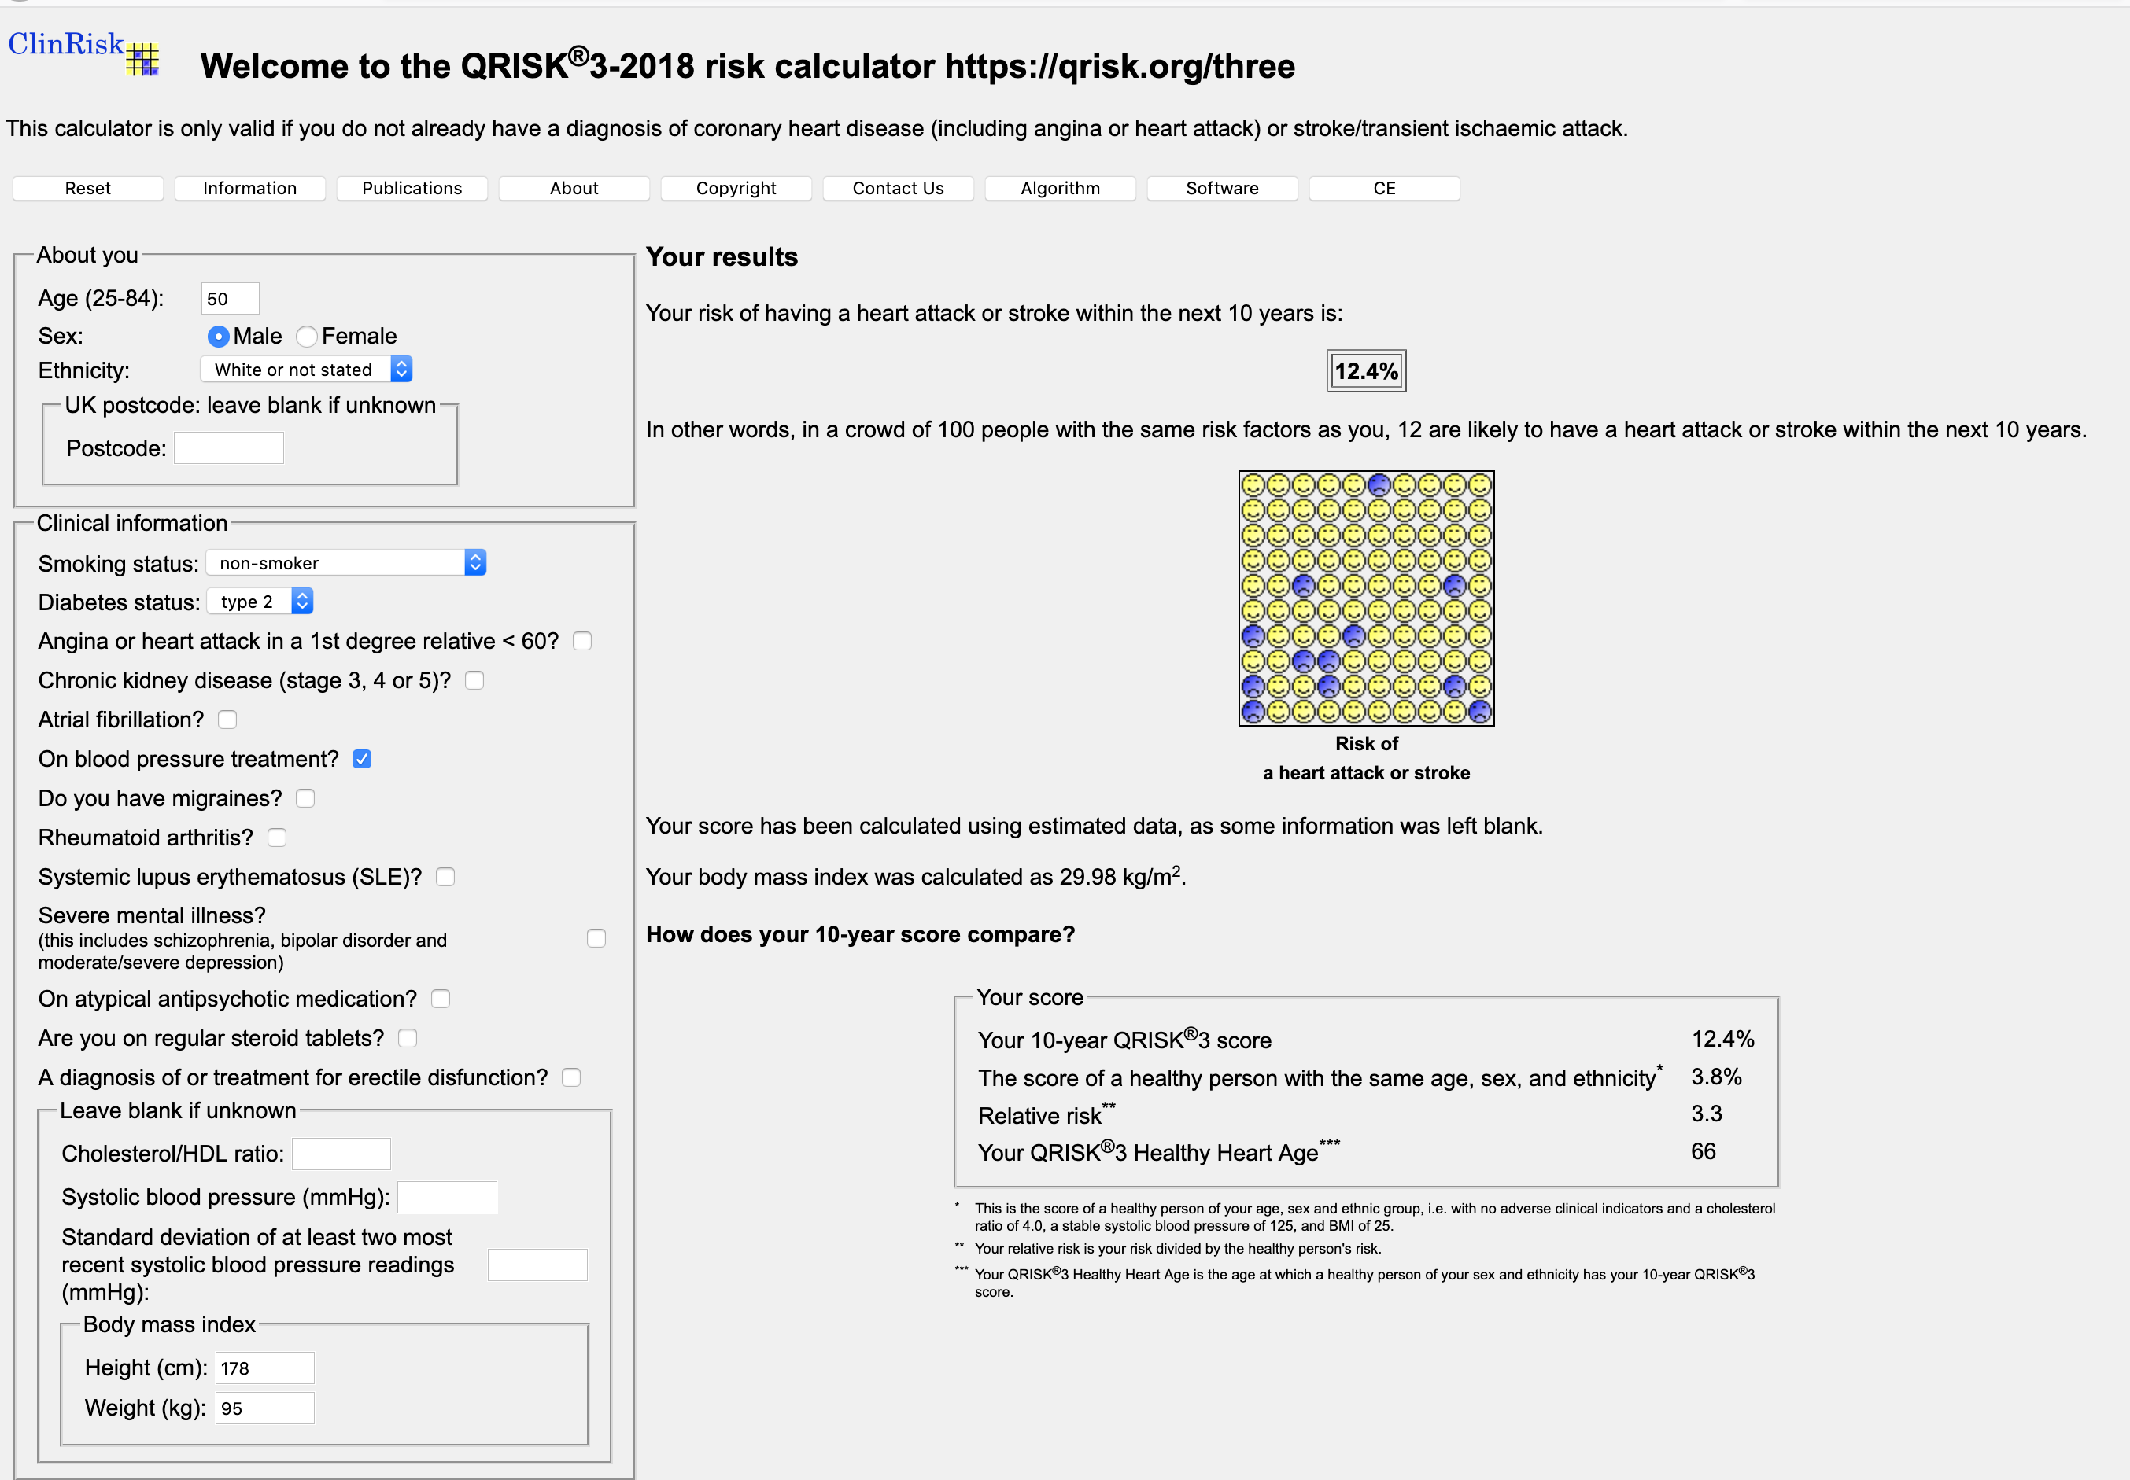
Applications
Screening
Triage
Prevention
chronic disease
cancer recurrence
hospital readmission
Benchmarking of clinical performance

Slide 10
Applications
Screening
Triage
Prevention
chronic disease
cancer recurrence
hospital readmission
Benchmarking of clinical performance

Slide 11
Applications
Screening
Triage
Prevention
chronic disease
cancer recurrence
acute care
Benchmarking of clinical performance

Slide 12
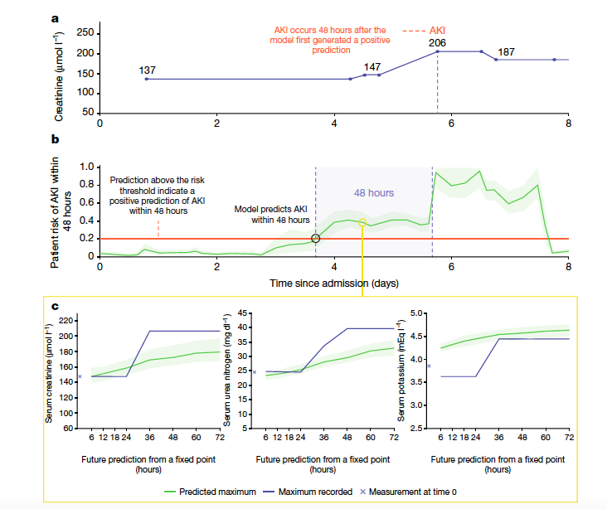
Applications
Screening
Triage
Prevention
chronic disease
cancer recurrence
acute care
Benchmarking of clinical performance

Slide 13
Applications
Screening
Triage
Prevention
chronic disease
cancer recurrence
acute care
Benchmarking of clinical performance

Slide 14
Assessing the quality of critical care
Suppose we wish to compare the performance of the intensive care units (ICUs) in two different hospitals.
A
B
Mortality: 25% 15%

Slide 15
Case mix variation in ICUs
Admission types
Medical 34.1% 6.9% – 81.8%
Emergency surgery 14.1% 3.5% – 40.5%
Planned surgery 51.8% 16.6% – 92.7%
Mean age: 62.2 55.4 – 67.1
Chronic diagnoses: 24.5% 8.6% – 51.8%

Slide 16
Case mix correction
ICU
patient case mix
prognostic model
observedoutcomes
expectedoutcomes
compare

Slide 17
Assessing the quality of critical care
Suppose we wish to compare the performance of the intensive care units (ICUs) in two different hospitals.
A
B
Mortality: 25% 15%
Expected: 30% 12%
Standardised Mortality Ratio: 0.83 1.25

Slide 18
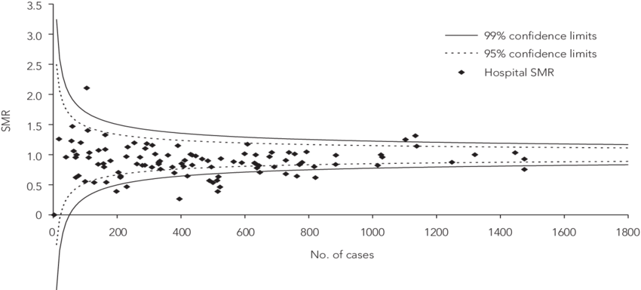
Funnel plots

Slide 19
Summary
Screening
Triage
Prevention
chronic disease
cancer recurrence
acute care
Benchmarking of clinical performance

Slide 20
Further reading
Steyerberg EW. Clinical Prediction Models. A Practical Approach to Development, Validation, and Updating. Springer, 2009.
Riley R. et al., Prognosis Research in Healthcare: Concepts, Methods, and Impact. Oxford Univ Press, 2019.
Hemingway H. et al., Prognosis research strategy (PROGRESS). -- BMJ 2013;346:e5595 doi: 10.1136/bmj.e5595. -- PLoS Med. 2013;10(2):e1001380. doi: 10.1371/journal.pmed.1001380. -- PLoS Med. 2013;10(2):e1001381. doi: 10.1371/journal.pmed.1001381. -- BMJ. 2013 Feb 5;346:e5793. doi: 10.1136/bmj.e5793.
Hippisley-Cox J et al. Development and validation of QRISK3 risk prediction algorithms to estimate future risk of cardiovascular disease. BMJ. 2017 May;357:j2099. doi: 10.1136/bmj.j2099.
Tomašev N, et al. A clinically applicable approach to continuous prediction of future acute kidney injury. Nature. 2019 Aug;572(7767):116-119. doi: 10.1038/s41586-019-1390-1.

Slide 21

Questions?

